Slide 1

Flawfinder – A Tool Analysis for Determining Security Weakness
Software Testing
Presentation for Exercise
Siddique Reza Khan
MSc in Cyber Security
Matrikel-Nr.:3846259
21.01.2019
Supervisor: Prof. Monika Heiner

Slide 2
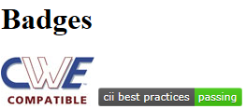
Introduction
A simple tool
Examines C/C++ source code
Reports possible security weaknesses (“flaws”) sorted by risk level
Very useful
Quickly finding and
Removing at least some potential security problems
Open source software(OSS)
Publically available to use
Flawfinder works on
GNU/Linux systems and
Windows by using Cygwin.
It requires Python 2.7 or Python 3 to run
Siddiqre Reza Khan, 3846259

Slide 3
Tool Comparison
Flawfinder:
Scans C/C++ code
Database of 128 C/C++ vulnerabilities.
Reporting warnings of 6 levels, form level 0 to 5,
ITS4: “It's The Software Stupid! Security Scanner”.
Scans C/C++ code
Database has 144 vulnerabilities.
6 levels of reporting warnings, level 0 to 5
RATS: “Rough Automatic Tool for Security”.
Scans C/C++, Python, PHP and Perl source code.
Rats has 3 levels of reporting warnings, Low, Medium and High
Siddiqre Reza Khan, 3846259

Slide 4
Downloading and Installing
The current version - 2.0.7
Linux-based system
First, download flawfinder in .tar.gz (tarball) format
https://dwheeler.com/flawfinder/flawfinder-2.0.7.tar.gz
Install
First, uncompress the file
Become root to install:
tar xvzf flawfinder-*.tar.gz
cd flawfinder-*
Then install we can do this (omit "sudo" if you are root)
1. sudo make prefix=/usr install
If you use Windows, the recommended way is to install Cygwin first, and install it on top of Cygwin.
Siddiqre Reza Khan, 3846259

Slide 5
Speed
Flawfinder is written in Python
Python code is not as fast as C code
Averaged analysis speed of 45,126 lines/second
OS - Linux kernel
CPU - Intel Core 2 Duo CPU E8400
Speed - 3.00GHz (each CPU running at 2GHz)
Averaged 24,475 lines/second
OS – Windows
Environment - 2.8GHz laptop and Cygwin
Cygwin on Windows tends to be much slower than Linux
Siddiqre Reza Khan, 3846259
Notes:
, to simplify the task of writing and extending it.
The speed reported begins when the program starts running, not including the fixed Python start-up time.

Slide 6
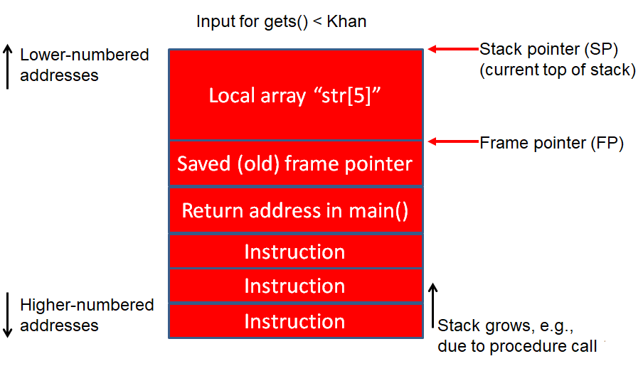
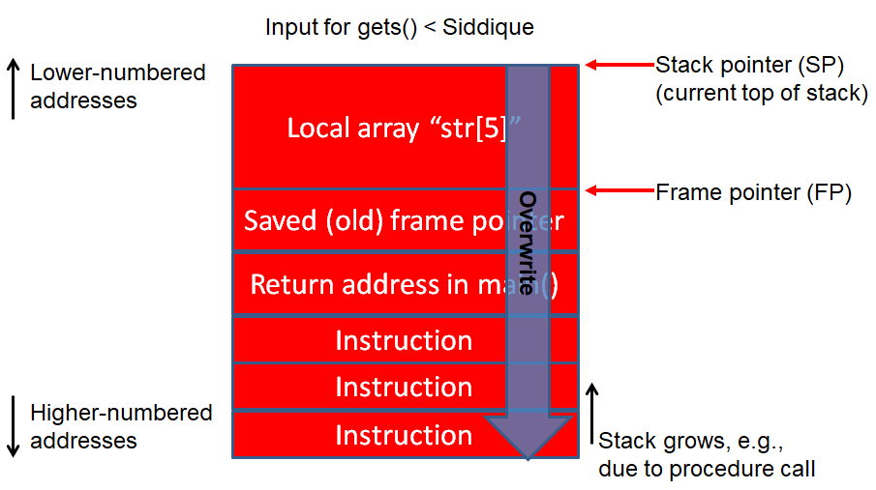
Buffer Overflow Risk
Programmer
Attacker
Program crash:
Enter a value: Siddique
Segmentation Fault
Correct output:
Enter a value : Khan
You entered: Khan
Siddiqre Reza Khan, 3846259
Notes:
C Programming Language Video Tutorials for Beginners ( COMPLETE SERIES )
LearningLad1 / 178
45, 51, 52, 53, 9, 10, 65, 66, 105,
Flawfinder is not a sophisticated tool. It is an intentionally simple tool, but people have found it useful.
Flawfinder works by using a built-in database of C/C++ functions with well-known problems, such as buffer overflow risks (e.g., strcpy(), strcat(), gets(), sprintf(), and the scanf() family), format string problems ([v][f]printf(), [v]snprintf(), and syslog()), race conditions (such as access(), chown(), chgrp(), chmod(), tmpfile(), tmpnam(), tempnam(), and mktemp()), potential shell metacharacter dangers (most of the exec() family, system(), popen()), and poor random number acquisition (such as random()). The good thing is that you don’t have to create this database - it comes with the tool.
Flawfinder then takes the source code text, and matches the source code text against those names, while ignoring text inside comments and strings (except for flawfinder directives). Flawfinder also knows about gettext (a common library for internationalized programs), and will treat constant strings passed through gettext as though they were constant strings; this reduces the number of false hits in internationalized programs.
Flawfinder produces a list of “hits” (potential security flaws), sorted by risk; by default the riskiest hits are shown first. This risk level depends not only on the function, but on the values of the parameters of the function. For example, constant strings are often less risky than fully variable strings in many contexts. In some cases, flawfinder may be able to determine that the construct isn’t risky at all, reducing false positives.

Slide 7
How does Flawfinder Work?(cont. 1/2)
Programmer
Attacker
/** Vulnerable Program */
#include <stdio.h>
//statements
void getName()
{ char str[5];
printf( "Enter your name :");
gets( str );
printf( "\nYou entered: ");
puts( str );
}
int main( )
{
//Statements
getName() /** Function Call */
//Statements
return 0;
}
Flawfinder Tool
/** Database*/
/** C library functions considered Harmful */
strcpy() // Buffer overflow risks
strcat() // Buffer overflow risks
gets() // Buffer overflow risks
sprintf() // Buffer overflow risks
scanf() // Buffer overflow risks
printf() // Format string problems
snprintf() // Format string problems
system() // shell metacharacter dangers
popen()// shell metacharacter dangers
/** Database of 128 C/C++ vulnerabilities */
Match found
by Lexical
Analysis,
so, 1 hit
Program crash:
Enter a value: Siddique
Segmentation Fault
Program crash:
Enter a value: Siddique
Segmentation Fault
Correct output:
Enter a value : Khan
You entered: Khan
Siddiqre Reza Khan, 3846259
Notes:
C Programming Language Video Tutorials for Beginners ( COMPLETE SERIES )
LearningLad1 / 178
45, 51, 52, 53, 9, 10, 65, 66, 105,
Flawfinder is not a sophisticated tool. It is an intentionally simple tool, but people have found it useful.
Flawfinder works by using a built-in database of C/C++ functions with well-known problems, such as buffer overflow risks (e.g., strcpy(), strcat(), gets(), sprintf(), and the scanf() family), format string problems ([v][f]printf(), [v]snprintf(), and syslog()), race conditions (such as access(), chown(), chgrp(), chmod(), tmpfile(), tmpnam(), tempnam(), and mktemp()), potential shell metacharacter dangers (most of the exec() family, system(), popen()), and poor random number acquisition (such as random()). The good thing is that you don’t have to create this database - it comes with the tool.
Flawfinder then takes the source code text, and matches the source code text against those names, while ignoring text inside comments and strings (except for flawfinder directives). Flawfinder also knows about gettext (a common library for internationalized programs), and will treat constant strings passed through gettext as though they were constant strings; this reduces the number of false hits in internationalized programs.
Flawfinder produces a list of “hits” (potential security flaws), sorted by risk; by default the riskiest hits are shown first. This risk level depends not only on the function, but on the values of the parameters of the function. For example, constant strings are often less risky than fully variable strings in many contexts. In some cases, flawfinder may be able to determine that the construct isn’t risky at all, reducing false positives.

Slide 8
How does Flawfinder Work?(cont. 2/2)
Analyze software C/C++ ﬁlename extensions
Can't build in some cases and can't even locally compile
Physical source lines of code (SLOC) analyzed
Built-in database of C/C++ functions
Matches the source code text against those function's names
Ignoring text inside comments except for flawfinder directives
// Flawﬁnder: ignore or /* Flawﬁnder: ignore */
Produces a list of “hits” sorted by risk,
Example "[0] 0[1] 9" means, at level 0 total 0 hits reported, and at level 1 total 9 hits reported; level 3+ has the sum of the number of hits at level 3, 4, and 5; KSLOC is each "level or higher" values multiplied by 1000 and divided by the physical SLOC
Siddiqre Reza Khan, 3846259
Notes:
common library for internationalized programs
Flawﬁnder is ofﬁcially CWE-Compatible. Hit descriptions with
"[MS-banned]" indicate functions that are in the banned list of functions released by Microsoft; see
http://msdn.microsoft.com/en-us/library/bb288454.aspx for more information about banned functions.

Slide 9
How does Flawfinder Work?
Not a sophisticated tool
Simple tool but useful
Built-in database of C/C++ functions
Buffer overflow risks (e.g., strcpy(), strcat(), gets(), sprintf(), and the scanf() family),
Format string problems (printf(), snprintf(), and syslog()),
Race conditions (such as access(), chown(), chgrp(), chmod(), tmpfile(), tmpnam(), tempnam(), and mktemp()),
Potential shell metacharacter dangers (most of the exec() family, system(), popen()), and
Poor random number acquisition (such as random()).
No need to create this database - it comes with the tool.
Siddiqre Reza Khan, 3846259
Notes:
C Programming Language Video Tutorials for Beginners ( COMPLETE SERIES )
LearningLad1 / 178
45, 51, 52, 53, 9, 10, 65, 66, 105,
Flawfinder is not a sophisticated tool. It is an intentionally simple tool, but people have found it useful.
Flawfinder works by using a built-in database of C/C++ functions with well-known problems, such as buffer overflow risks (e.g., strcpy(), strcat(), gets(), sprintf(), and the scanf() family), format string problems ([v][f]printf(), [v]snprintf(), and syslog()), race conditions (such as access(), chown(), chgrp(), chmod(), tmpfile(), tmpnam(), tempnam(), and mktemp()), potential shell metacharacter dangers (most of the exec() family, system(), popen()), and poor random number acquisition (such as random()). The good thing is that you don’t have to create this database - it comes with the tool.
Flawfinder then takes the source code text, and matches the source code text against those names, while ignoring text inside comments and strings (except for flawfinder directives). Flawfinder also knows about gettext (a common library for internationalized programs), and will treat constant strings passed through gettext as though they were constant strings; this reduces the number of false hits in internationalized programs.
Flawfinder produces a list of “hits” (potential security flaws), sorted by risk; by default the riskiest hits are shown first. This risk level depends not only on the function, but on the values of the parameters of the function. For example, constant strings are often less risky than fully variable strings in many contexts. In some cases, flawfinder may be able to determine that the construct isn’t risky at all, reducing false positives.

Slide 10
How does Flawfinder Work?
Gives better information - and better prioritization
ignore comments and the insides of strings
examine parameters to estimate risk levels
Fundamentally a naive program
Doesn’t know about the data types of function parameters
Doesn’t do control flow or data flow analysis
As example, other tools, like SPLINT, which do deeper analysis
Analyze software
Can't build in some cases
Can't even locally compile
Siddiqre Reza Khan, 3846259

Slide 11
How does Flawfinder Work?
During audited a program
Can mark source code lines that are actually ﬁne but cause false warnings
To stop complaining about them
Put a specially-formatted comment either on the same line (after the source code)
All by itself in the previous line.
The comment must have one of the two following formats:
// Flawﬁnder: ignore
/* Flawﬁnder: ignore */
Siddiqre Reza Khan, 3846259

Slide 12
How does Flawfinder Work?
Any ﬁle name can examined
Doesn’t have a usual C/C++ ﬁlename extension
Can force to examine any speciﬁc ﬁles
Examines regular ﬁles
C/C++ ﬁlename extensions
Presumes that ﬁles are C/C++ ﬁles
Have the extensions ".c", ".h", ".ec", ".ecp", ".pgc", ".C", ".cpp", ".CPP", ".cxx", ".cc", ".CC", ".pcc", ".hpp", or ".H".
Physical source lines of code (SLOC) analyzed
Non-blank, non-comment line
Number of hits at each level
Never be a hit at a level lower than min level (1 by default)
"[0] 0[1] 9" means, at level 0 total 0 hits reported, and at level 1 total 9 hits reported
Number of hits at a given level or larger
Example, level 3+ has the sum of the number of hits at level 3, 4, and 5.
KSLOC
each "level or higher" values multiplied by 1000 and divided by the physical SLOC
The minimum risk level is displayed
By default this is 1
Siddiqre Reza Khan, 3846259

Slide 13
How does Flawfinder Work?
Important reminders:
Not every hit is necessarily a security vulnerability
There may be other security vulnerabilities not reported by the tool.
Siddiqre Reza Khan, 3846259

Slide 14
Options
Number of options and they are grouped into options
Control its own documentation
Select which hits to display
Select the output format and
Perform hit list management
Long option arguments
Provided as ‘‘--name=value’’ or ‘‘-name value’’.
Siddiqre Reza Khan, 3846259

Slide 15
Options : Documentation
−−help or −h
Show usage (help) information.
−−version
Shows (just) the version number and exits.
−−listrules
List the terms (tokens) that trigger further examination
Default risk level, and
Default warning (including the CWE identiﬁer(s), if applicable), all tab-separated.
Called potentially-dangerous functions.
Reported risk level and warning
Speciﬁc code may be different than the default
Combine with −D if you do not want the usual header
Siddiqre Reza Khan, 3846259

Slide 16
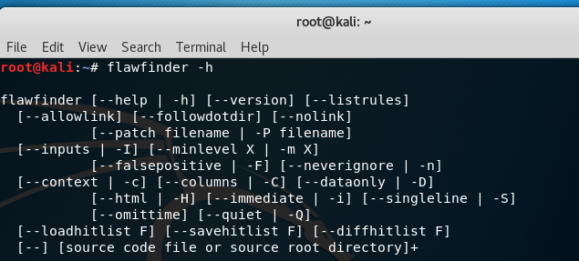
Options : Documentation
−−help or −h
Show usage (help) information.
Siddiqre Reza Khan, 3846259

Slide 17

Options : Documentation
−−version
Shows (just) the version number and exits.
Siddiqre Reza Khan, 3846259

Slide 18
Options : Documentation
−−listrules
List the terms (tokens) that trigger further examination
Combine with −D if you do not want the usual header
Siddiqre Reza Khan, 3846259

Slide 19
Options : Selecting Hits to Display
−−inputs or −I
Show only functions that obtain data from outside the program.
−−minlevel=X or -m X
Set minimum risk level to X for inclusion in hit list. This can be from 0 (‘‘no risk’’) to 5 (‘‘maximum risk’’); the default is 1.
−−falsepositive or −F
Do not include hits that are likely to be false positives.
Currently, this means that function names are ignored if they’re not followed by "(", and that declarations of character arrays aren’t noted.
−−neverignore or -n
Never ignore security issues, even if they have an ‘‘ignore’’ directive in a comment.
−−regexp=PATTERN or -e PATTERN
Only report hits with text that matches the regular expression pattern PATTERN.
For example, to only report hits containing the text "CWE-120", use ‘‘−−regex CWE-120’’.
Siddiqre Reza Khan, 3846259

Slide 20
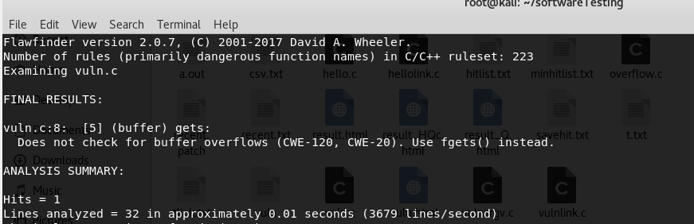
Options : Selecting Hits to Display
−−inputs or −I
Show only functions that obtain data from outside the program.
Siddiqre Reza Khan, 3846259

Slide 21
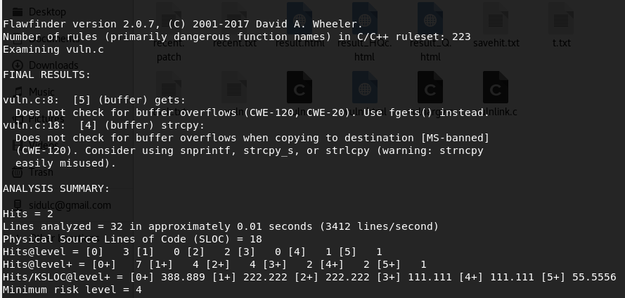
Options : Selecting Hits to Display
−−minlevel=X or -m X
Set minimum risk level to X for inclusion in hit list.
Siddiqre Reza Khan, 3846259

Slide 22
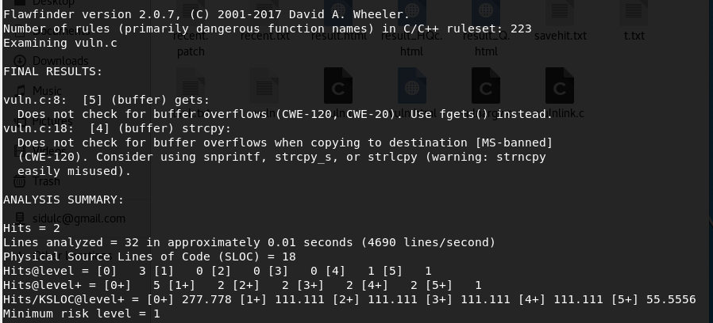
Options : Selecting Hits to Display
−−falsepositive or −F
Do not include hits that are likely to be false positives.
Siddiqre Reza Khan, 3846259

Slide 23
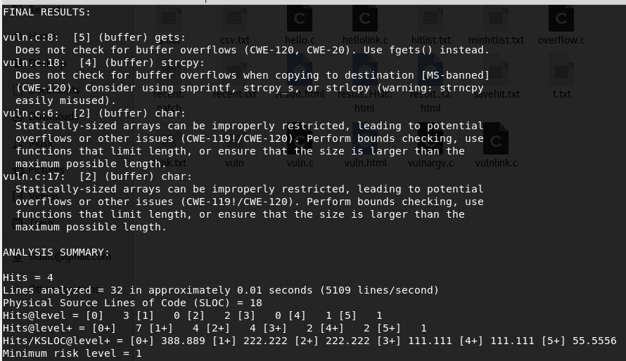
Options : Selecting Hits to Display
−−neverignore or -n
Never ignore security issues, even if they have an ‘‘ignore’’ directive in a comment.
Siddiqre Reza Khan, 3846259

Slide 24
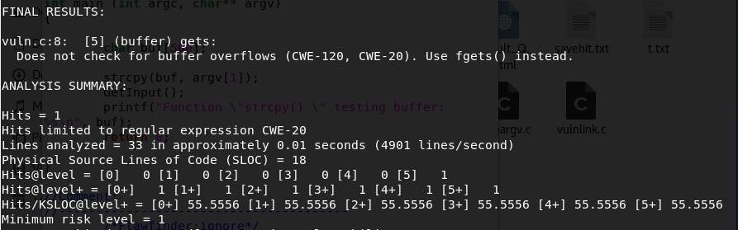
Options : Selecting Hits to Display
−−regexp=PATTERN or -e PATTERN
Only report hits with text that matches the regular expression pattern PATTERN.
Siddiqre Reza Khan, 3846259

Slide 25
Options : Selecting Output Format
−−columns or −C
Show the column number (as well as the ﬁle name and line number) of each hit;
−−context or −c
Show context, i.e., the line having the "hit"/potential ﬂaw. By default the line is shown immediately after the warning.
−−csv
Generate output in comma-separated-value (CSV) format.
Selecting this option automatically enables −−quiet and −−dataonly.
The headers are mostly self-explanatory.
"File" is the ﬁlename,
"Line" is the line number,
"Column" is the column (starting from 1),
"Level" is the risk level (0-5, 5 is riskiest),
"Category" is the general ﬂawﬁnder category,
"Name" is the name of the triggering rule,
"Warning" is text explaining why it is a hit (ﬁnding),
"Suggestion" is text suggesting how it might be ﬁxed,
"Note" is other explanatory notes,
"CWEs" is the list of one or more CWEs,
"Context" is the source code line triggering the hit, and
"Fingerprint" is the SHA-256 hash of the context once its leading and trailing whitespace have been removed.
Siddiqre Reza Khan, 3846259
Notes:
this is shown after the line number by adding a colon and the column number in the line (the ﬁrst character in a line is column number 1). This is useful for editors that can jump to speciﬁc columns, or for integrating with other tools (such as those to further ﬁlter out false positives).
This is the recommended format for sending to other tools for processing. It will always generate a header row, followed by 0 or more data rows (one data rowfor each hit).
The headers are mostly self-explanatory."File" is the ﬁlename, "Line" is the line number,"Column" is the column (starting from 1), "Level" is the risk level (0-5, 5 is riskiest), "Category" is the general ﬂawﬁnder category,"Name" is the name of the triggering rule, "Warning" is text explaining why it is a hit (ﬁnding), "Suggestion" is text suggesting how it might be ﬁxed, "Note" is other explanatory notes, "CWEs" is the list of one or more CWEs, "Context" is the source code line triggering the hit, and "Fingerprint" is the SHA-256 hash of the context once its leading and trailing whitespace have been removed (the ﬁngerprint may help detect and eliminate later duplications). If you use Python3, the hash is of the context when encoded as UTF-8.

Slide 26
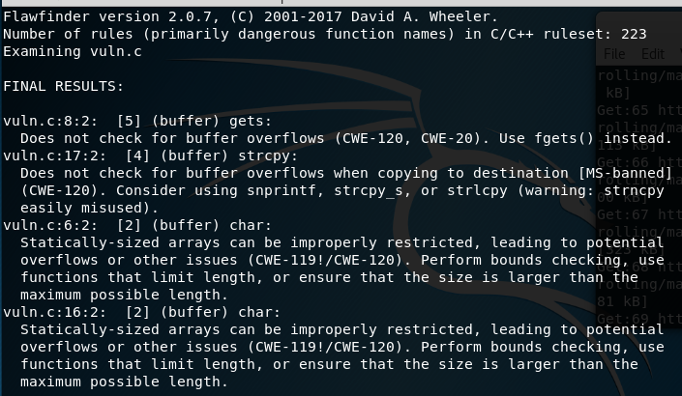
Options : Selecting Output Format
−−columns or −C
Show the column number (as well as the ﬁle name and line number) of each hit;
Siddiqre Reza Khan, 3846259
Notes:
this is shown after the line number by adding a colon and the column number in the line (the ﬁrst character in a line is column number 1). This is useful for editors that can jump to speciﬁc columns, or for integrating with other tools (such as those to further ﬁlter out false positives).
This is the recommended format for sending to other tools for processing. It will always generate a header row, followed by 0 or more data rows (one data rowfor each hit).
The headers are mostly self-explanatory."File" is the ﬁlename, "Line" is the line number,"Column" is the column (starting from 1), "Level" is the risk level (0-5, 5 is riskiest), "Category" is the general ﬂawﬁnder category,"Name" is the name of the triggering rule, "Warning" is text explaining why it is a hit (ﬁnding), "Suggestion" is text suggesting how it might be ﬁxed, "Note" is other explanatory notes, "CWEs" is the list of one or more CWEs, "Context" is the source code line triggering the hit, and "Fingerprint" is the SHA-256 hash of the context once its leading and trailing whitespace have been removed (the ﬁngerprint may help detect and eliminate later duplications). If you use Python3, the hash is of the context when encoded as UTF-8.

Slide 27
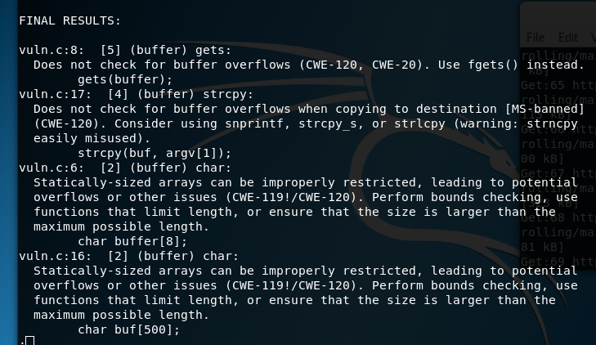
Options : Selecting Output Format
−−context or −c
Show context, i.e., the line having the "hit"/potential ﬂaw. By default the line is shown immediately after the warning.
Siddiqre Reza Khan, 3846259
Notes:
this is shown after the line number by adding a colon and the column number in the line (the ﬁrst character in a line is column number 1). This is useful for editors that can jump to speciﬁc columns, or for integrating with other tools (such as those to further ﬁlter out false positives).
This is the recommended format for sending to other tools for processing. It will always generate a header row, followed by 0 or more data rows (one data rowfor each hit).
The headers are mostly self-explanatory."File" is the ﬁlename, "Line" is the line number,"Column" is the column (starting from 1), "Level" is the risk level (0-5, 5 is riskiest), "Category" is the general ﬂawﬁnder category,"Name" is the name of the triggering rule, "Warning" is text explaining why it is a hit (ﬁnding), "Suggestion" is text suggesting how it might be ﬁxed, "Note" is other explanatory notes, "CWEs" is the list of one or more CWEs, "Context" is the source code line triggering the hit, and "Fingerprint" is the SHA-256 hash of the context once its leading and trailing whitespace have been removed (the ﬁngerprint may help detect and eliminate later duplications). If you use Python3, the hash is of the context when encoded as UTF-8.

Slide 28
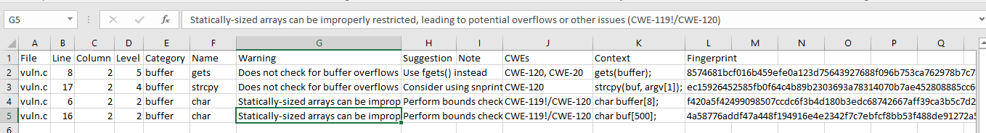
Options : Selecting Output Format
−−csv
Generate output in comma-separated-value (CSV) format.
Siddiqre Reza Khan, 3846259
Notes:
this is shown after the line number by adding a colon and the column number in the line (the ﬁrst character in a line is column number 1). This is useful for editors that can jump to speciﬁc columns, or for integrating with other tools (such as those to further ﬁlter out false positives).
This is the recommended format for sending to other tools for processing. It will always generate a header row, followed by 0 or more data rows (one data rowfor each hit).
The headers are mostly self-explanatory."File" is the ﬁlename, "Line" is the line number,"Column" is the column (starting from 1), "Level" is the risk level (0-5, 5 is riskiest), "Category" is the general ﬂawﬁnder category,"Name" is the name of the triggering rule, "Warning" is text explaining why it is a hit (ﬁnding), "Suggestion" is text suggesting how it might be ﬁxed, "Note" is other explanatory notes, "CWEs" is the list of one or more CWEs, "Context" is the source code line triggering the hit, and "Fingerprint" is the SHA-256 hash of the context once its leading and trailing whitespace have been removed (the ﬁngerprint may help detect and eliminate later duplications). If you use Python3, the hash is of the context when encoded as UTF-8.

Slide 29
Options : Selecting Output Format
−D
Don’t display the header and footer. Use this along with −−quiet to see just the data itself.
−−html or −H
Format the output as HTML instead of as simple text.
−−immediate or -i
Immediately display hits (don’t just wait until the end).
−−singleline or -S
Display as single line of text output for each hit. Useful for interacting with compilation tools.
−−omittime
Omit timing information. This is useful for regression tests of ﬂawﬁnder itself, so that the output doesn’t vary depending on how long the analysis takes.
−−quiet or −Q
Don’t display status information (i.e., which ﬁles are being examined) while the analysis is going on.
Siddiqre Reza Khan, 3846259
Notes:
this is shown after the line number by adding a colon and the column number in the line (the ﬁrst character in a line is column number 1). This is useful for editors that can jump to speciﬁc columns, or for integrating with other tools (such as those to further ﬁlter out false positives).
This is the recommended format for sending to other tools for processing. It will always generate a header row, followed by 0 or more data rows (one data rowfor each hit).
The headers are mostly self-explanatory."File" is the ﬁlename, "Line" is the line number,"Column" is the column (starting from 1), "Level" is the risk level (0-5, 5 is riskiest), "Category" is the general ﬂawﬁnder category,"Name" is the name of the triggering rule, "Warning" is text explaining why it is a hit (ﬁnding), "Suggestion" is text suggesting how it might be ﬁxed, "Note" is other explanatory notes, "CWEs" is the list of one or more CWEs, "Context" is the source code line triggering the hit, and "Fingerprint" is the SHA-256 hash of the context once its leading and trailing whitespace have been removed (the ﬁngerprint may help detect and eliminate later duplications). If you use Python3, the hash is of the context when encoded as UTF-8.

Slide 30
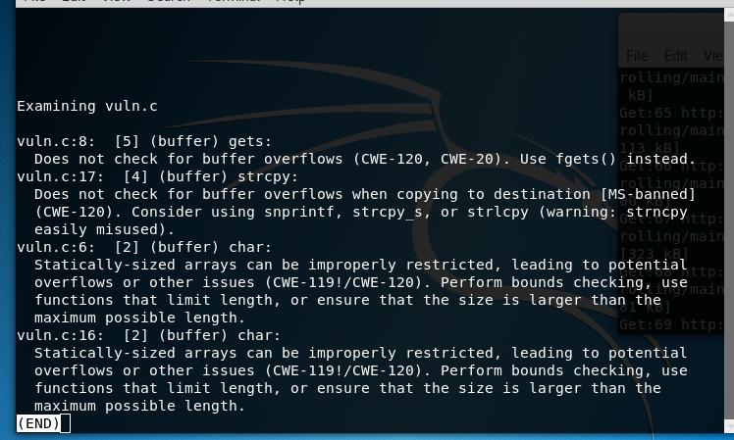
Options : Selecting Output Format
−D
Don’t display the header and footer. Use this along with −−quiet to see just the data itself.
Siddiqre Reza Khan, 3846259
Notes:
this is shown after the line number by adding a colon and the column number in the line (the ﬁrst character in a line is column number 1). This is useful for editors that can jump to speciﬁc columns, or for integrating with other tools (such as those to further ﬁlter out false positives).
This is the recommended format for sending to other tools for processing. It will always generate a header row, followed by 0 or more data rows (one data rowfor each hit).
The headers are mostly self-explanatory."File" is the ﬁlename, "Line" is the line number,"Column" is the column (starting from 1), "Level" is the risk level (0-5, 5 is riskiest), "Category" is the general ﬂawﬁnder category,"Name" is the name of the triggering rule, "Warning" is text explaining why it is a hit (ﬁnding), "Suggestion" is text suggesting how it might be ﬁxed, "Note" is other explanatory notes, "CWEs" is the list of one or more CWEs, "Context" is the source code line triggering the hit, and "Fingerprint" is the SHA-256 hash of the context once its leading and trailing whitespace have been removed (the ﬁngerprint may help detect and eliminate later duplications). If you use Python3, the hash is of the context when encoded as UTF-8.

Slide 31
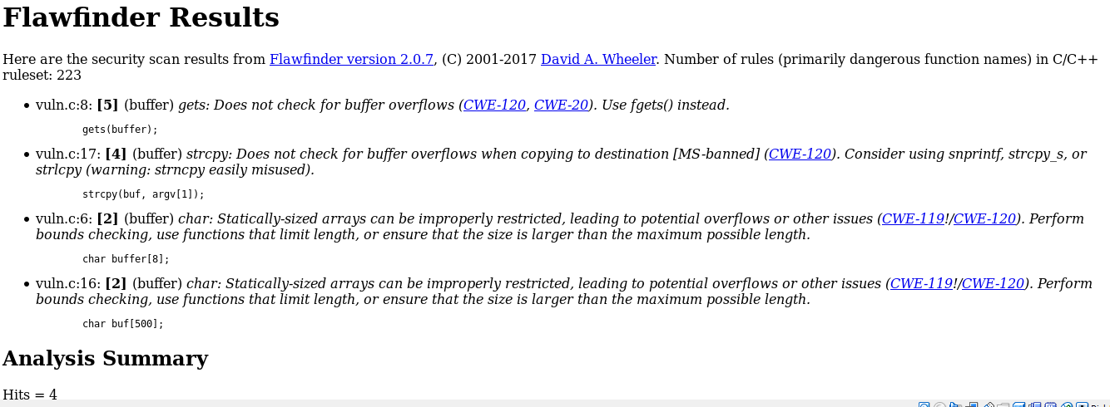
Options : Selecting Output Format
−−html or −H
Format the output as HTML instead of as simple text.
Siddiqre Reza Khan, 3846259
Notes:
this is shown after the line number by adding a colon and the column number in the line (the ﬁrst character in a line is column number 1). This is useful for editors that can jump to speciﬁc columns, or for integrating with other tools (such as those to further ﬁlter out false positives).
This is the recommended format for sending to other tools for processing. It will always generate a header row, followed by 0 or more data rows (one data rowfor each hit).
The headers are mostly self-explanatory."File" is the ﬁlename, "Line" is the line number,"Column" is the column (starting from 1), "Level" is the risk level (0-5, 5 is riskiest), "Category" is the general ﬂawﬁnder category,"Name" is the name of the triggering rule, "Warning" is text explaining why it is a hit (ﬁnding), "Suggestion" is text suggesting how it might be ﬁxed, "Note" is other explanatory notes, "CWEs" is the list of one or more CWEs, "Context" is the source code line triggering the hit, and "Fingerprint" is the SHA-256 hash of the context once its leading and trailing whitespace have been removed (the ﬁngerprint may help detect and eliminate later duplications). If you use Python3, the hash is of the context when encoded as UTF-8.

Slide 32
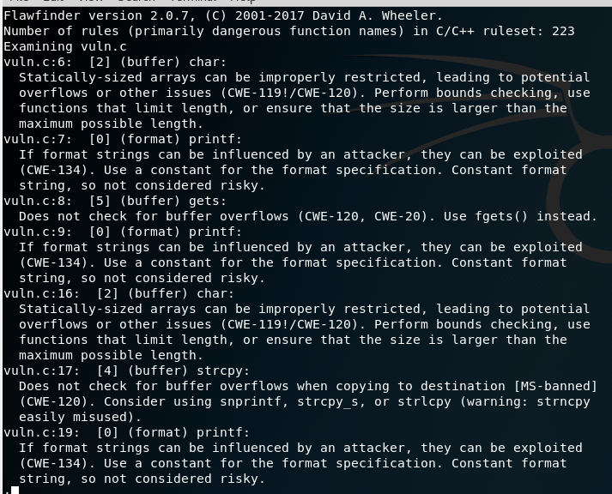
Options : Selecting Output Format
−−immediate or -i
Immediately display hits (don’t just wait until the end).
Siddiqre Reza Khan, 3846259
Notes:
this is shown after the line number by adding a colon and the column number in the line (the ﬁrst character in a line is column number 1). This is useful for editors that can jump to speciﬁc columns, or for integrating with other tools (such as those to further ﬁlter out false positives).
This is the recommended format for sending to other tools for processing. It will always generate a header row, followed by 0 or more data rows (one data rowfor each hit).
The headers are mostly self-explanatory."File" is the ﬁlename, "Line" is the line number,"Column" is the column (starting from 1), "Level" is the risk level (0-5, 5 is riskiest), "Category" is the general ﬂawﬁnder category,"Name" is the name of the triggering rule, "Warning" is text explaining why it is a hit (ﬁnding), "Suggestion" is text suggesting how it might be ﬁxed, "Note" is other explanatory notes, "CWEs" is the list of one or more CWEs, "Context" is the source code line triggering the hit, and "Fingerprint" is the SHA-256 hash of the context once its leading and trailing whitespace have been removed (the ﬁngerprint may help detect and eliminate later duplications). If you use Python3, the hash is of the context when encoded as UTF-8.

Slide 33
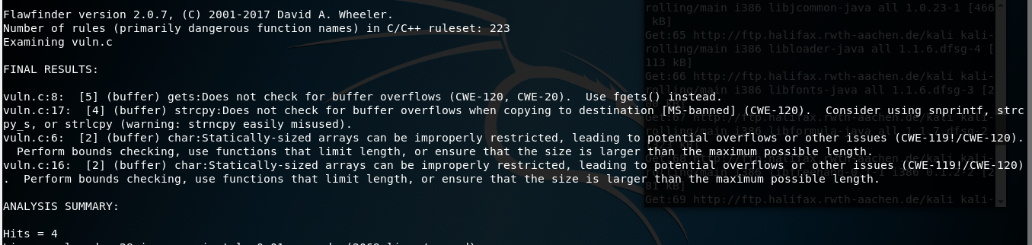
Options : Selecting Output Format
−−singleline or -S
Display as single line of text output for each hit. Useful for interacting with compilation tools.
Siddiqre Reza Khan, 3846259
Notes:
this is shown after the line number by adding a colon and the column number in the line (the ﬁrst character in a line is column number 1). This is useful for editors that can jump to speciﬁc columns, or for integrating with other tools (such as those to further ﬁlter out false positives).
This is the recommended format for sending to other tools for processing. It will always generate a header row, followed by 0 or more data rows (one data rowfor each hit).
The headers are mostly self-explanatory."File" is the ﬁlename, "Line" is the line number,"Column" is the column (starting from 1), "Level" is the risk level (0-5, 5 is riskiest), "Category" is the general ﬂawﬁnder category,"Name" is the name of the triggering rule, "Warning" is text explaining why it is a hit (ﬁnding), "Suggestion" is text suggesting how it might be ﬁxed, "Note" is other explanatory notes, "CWEs" is the list of one or more CWEs, "Context" is the source code line triggering the hit, and "Fingerprint" is the SHA-256 hash of the context once its leading and trailing whitespace have been removed (the ﬁngerprint may help detect and eliminate later duplications). If you use Python3, the hash is of the context when encoded as UTF-8.

Slide 34

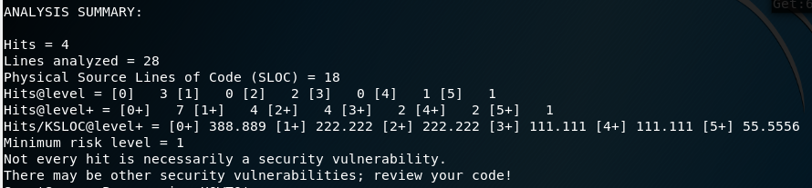
Options : Selecting Output Format
−−omittime
Omit timing information. This is useful for regression tests of ﬂawﬁnder itself, so that the output doesn’t vary depending on how long the analysis takes.
Siddiqre Reza Khan, 3846259
Notes:
this is shown after the line number by adding a colon and the column number in the line (the ﬁrst character in a line is column number 1). This is useful for editors that can jump to speciﬁc columns, or for integrating with other tools (such as those to further ﬁlter out false positives).
This is the recommended format for sending to other tools for processing. It will always generate a header row, followed by 0 or more data rows (one data rowfor each hit).
The headers are mostly self-explanatory."File" is the ﬁlename, "Line" is the line number,"Column" is the column (starting from 1), "Level" is the risk level (0-5, 5 is riskiest), "Category" is the general ﬂawﬁnder category,"Name" is the name of the triggering rule, "Warning" is text explaining why it is a hit (ﬁnding), "Suggestion" is text suggesting how it might be ﬁxed, "Note" is other explanatory notes, "CWEs" is the list of one or more CWEs, "Context" is the source code line triggering the hit, and "Fingerprint" is the SHA-256 hash of the context once its leading and trailing whitespace have been removed (the ﬁngerprint may help detect and eliminate later duplications). If you use Python3, the hash is of the context when encoded as UTF-8.

Slide 35
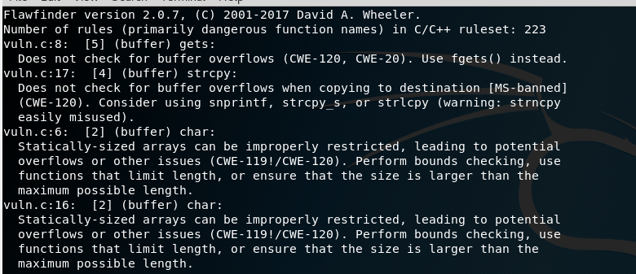
Options : Selecting Output Format
−quiet or −Q
Don’t display status information (i.e., which ﬁles are being examined) while the analysis is going on.
Siddiqre Reza Khan, 3846259
Notes:
this is shown after the line number by adding a colon and the column number in the line (the ﬁrst character in a line is column number 1). This is useful for editors that can jump to speciﬁc columns, or for integrating with other tools (such as those to further ﬁlter out false positives).
This is the recommended format for sending to other tools for processing. It will always generate a header row, followed by 0 or more data rows (one data rowfor each hit).
The headers are mostly self-explanatory."File" is the ﬁlename, "Line" is the line number,"Column" is the column (starting from 1), "Level" is the risk level (0-5, 5 is riskiest), "Category" is the general ﬂawﬁnder category,"Name" is the name of the triggering rule, "Warning" is text explaining why it is a hit (ﬁnding), "Suggestion" is text suggesting how it might be ﬁxed, "Note" is other explanatory notes, "CWEs" is the list of one or more CWEs, "Context" is the source code line triggering the hit, and "Fingerprint" is the SHA-256 hash of the context once its leading and trailing whitespace have been removed (the ﬁngerprint may help detect and eliminate later duplications). If you use Python3, the hash is of the context when encoded as UTF-8.

Slide 36
Options : Hitlist Management
−−savehitlist=F
Save all resulting hits (the "hitlist") to F.
−−loadhitlist=F
Load the hitlist from F instead of analyzing source programs.
Warning: Do not load hitlists from untrusted sources (for security reasons).
Siddiqre Reza Khan, 3846259

Slide 37
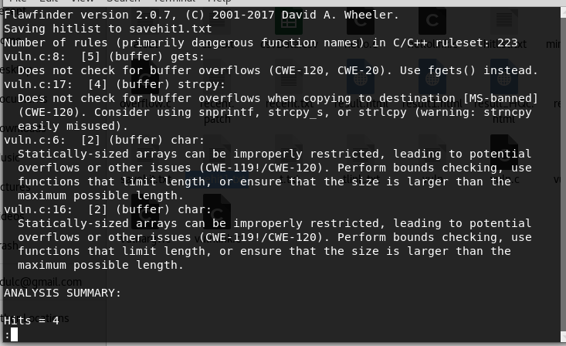
Options : Hitlist Management
−−savehitlist=F
Save all resulting hits (the "hitlist") to F
Siddiqre Reza Khan, 3846259

Slide 38
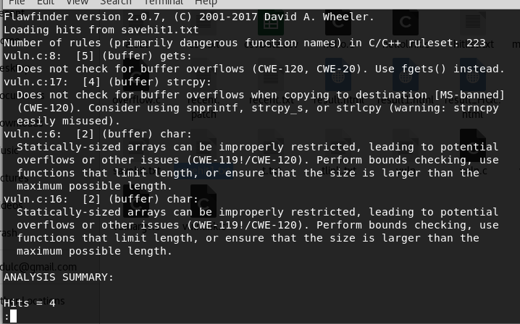
Options : Hitlist Management
−−loadhitlist=F
Load the hitlist from F instead of analyzing source programs
Siddiqre Reza Khan, 3846259

Slide 39
COMMON WEAKNESS ENUMERATION (CWE)
Flawﬁnder can report on the following CWEs (these are the CWEs that ﬂawﬁnder covers; ‘‘*’’marks those in the CWE/SANS top 25 list):
CWE-20: Improper Input Validation
CWE-22: Improper Limitation of a Pathname to a Restricted Directory (‘‘Path Traversal’’)
CWE-78: Improper Neutralization of Special Elements used in an OS Command (‘‘OS Command Injection’’)*
CWE-119: Improper Restriction of Operations within the Bounds of a Memory Buffer (a parent of CWE-120*, so this is shown as CWE-119!/CWE-120)
CWE-120: Buffer Copywithout Checking Size of Input (‘‘Classic Buffer Overﬂow’’)*
CWE-126: Buffer Over-read
CWE-134: Uncontrolled Format String*
CWE-190: Integer Overﬂow or Wraparound*
CWE-250: Execution with Unnecessary Privileges
CWE-327: Use of a Broken or RiskyCryptographic Algorithm*
CWE-362: Concurrent Execution using Shared Resource with Improper Synchronization (‘‘Race Condition’’)
CWE-377: Insecure Temporary File
CWE-676: Use of Potentially Dangerous Function*
CWE-732: Incorrect Permission Assignment for Critical Resource*
CWE-785: Use of Path Manipulation Function without Maximum-sized Buffer (child of CWE-120*, so this is shown as CWE-120/CWE-785)
CWE-807: Reliance on Untrusted Inputs in a Security Decision*
CWE-829: Inclusion of Functionality from Untrusted Control Sphere*
Siddiqre Reza Khan, 3846259
Notes:
se·man·tics
[səˈman(t)iks]
NOUN
logical semantics (noun) · lexical semantics (noun)
the branch of linguistics and logic concerned with meaning. There are a number of branches and subbranches of semantics, including formal semantics, which studies the logical aspects of meaning, such as sense, reference, implication, and logical form, lexical semantics, which studies word meanings and word relations, and conceptual semantics, which studies the cognitive structure of meaning.

Slide 40
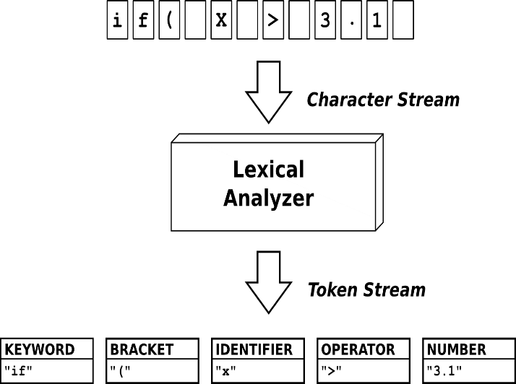
Conclusion
Useful as a simple introduction
To static analysis tools
Easy to start using and easy to understand.
Works by doing simple lexical tokenization
Looking for token matches to the database
Particularly to ﬁnd function calls
Examines the text of the function parameters to estimate risk
Does not use or have access to information about control ﬂow, data ﬂow,
when searching for potential vulnerabilities or estimating the level of risk.
Analyze a copy of the source code
Can ﬁnd vulnerabilities in programs that cannot be built or cannot be linked.
It can often work with programs that cannot even be compiled
Source: http://quex.sourceforge.net/
It is licensed under MIT License.
Siddiqre Reza Khan, 3846259
Notes:
se·man·tics
[səˈman(t)iks]
NOUN
logical semantics (noun) · lexical semantics (noun)
the branch of linguistics and logic concerned with meaning. There are a number of branches and subbranches of semantics, including formal semantics, which studies the logical aspects of meaning, such as sense, reference, implication, and logical form, lexical semantics, which studies word meanings and word relations, and conceptual semantics, which studies the cognitive structure of meaning.

Slide 41
Conclusion
Not every hit a security vulnerability
Not every security vulnerability is necessarily found
Doesn’t understand the semantics of the code
Does simple text pattern matching
Ignoring comments and strings
Doesn't do data flow or control flow or data types analysis
Produce many false positives for vulnerabilities
Fail to report many vulnerabilities
Siddiqre Reza Khan, 3846259
Notes:
se·man·tics
[səˈman(t)iks]
NOUN
logical semantics (noun) · lexical semantics (noun)
the branch of linguistics and logic concerned with meaning. There are a number of branches and subbranches of semantics, including formal semantics, which studies the logical aspects of meaning, such as sense, reference, implication, and logical form, lexical semantics, which studies word meanings and word relations, and conceptual semantics, which studies the cognitive structure of meaning.

Slide 42
Tool Demonstration
Siddiqre Reza Khan, 3846259

Slide 43
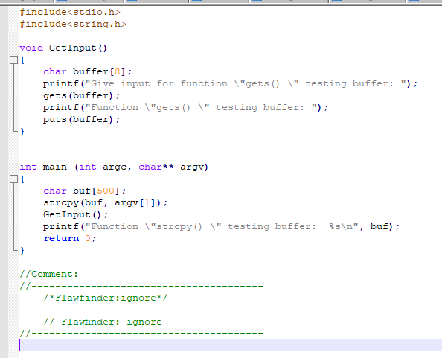
Example: For Demonstration C Code
Siddiqre Reza Khan, 3846259

Slide 44
Options : Example
flawfinder -m 4 vuln.c | less
Examine the C/C++ ﬁles in the current directory only report vulnerabilities level 4 and up (the two highest risk levels).
flawfinder -I vuln.c| less
Examine the C/C++ ﬁles in mydir, and report functions that take inputs (so that you can ensure that they ﬁlter the inputs appropriately).
flawfinder -n vuln.c | less
Examine the C/C++ ﬁles in the directory mydir or its subdirectories, including even the hits marked for ignoring in the code comments.
flawfinder --csv vuln.c >csvData.csv
Examine the current directory down and report all hits in CSV format.
flawfinder -QD vuln.c | less
Examine mydir and report only the actual results (removing the header and footer of the output).
Siddiqre Reza Khan, 3846259

Slide 45
Options : Example
flawfinder -QDSC vuln.c|less
Examine mydir, reporting only the actual results (no header or footer). Each hit is reported on one line, and column numbers are reported. This can be a useful command if you are feeding ﬂawﬁnder output to other tools.
flawfinder -QHc vuln.c>result.html
Examine all the C/C++ ﬁles in the directory mydir, and produce an HTML formatted version of the results.
flawfinder -Q --savehitlist savehit.txt vuln.c|less
Examine ﬁle in the current directory. Don’t report on the status of processing, and save the resulting hitlist (the set of all hits) in the ﬁle savehit.txt.
flawfinder --loadhitlist savehit.txt vuln.c|less
Examine ﬁle in the current directory, and show hits that were already in the ﬁle savehit.txt.
flawfinder --regex "CWE-119|CWE-120" vuln.c | less
Examine file, but only report hits where CWE-119 or CWE-120 apply.
Siddiqre Reza Khan, 3846259

Slide 46
Questions?
Siddiqre Reza Khan, 3846259

Slide 47
Bibliography
[1] David A. Wheeler, “Secure Programming HOWTO”, v3.72 Edition, 2015.
[2]Online: https://dwheeler.com/flawfinder/, “Flawfinder”, accessed on: 02.11.2018
[3]Online:https://www.debian.org/security/audit/examples/flawfinder, “Automated Audit Example: flawfinder”, accessed on: 02.11.2018
[4]Online: https://dwheeler.com/secure-class/index.html, “Secure Software Design and Programming: Class Materials by David A. Wheeler”, accessed on: 02.11.2018
[5]Online:http://manpages.ubuntu.com/manpages/bionic/man1/flawfinder.1.html, “flawfinder - lexically find potential security flaws ("hits") in source code ”, accessed on: 02.11.2018
[6]Online: https://dwheeler.com/flawfinder/flawfinder.pdf, ”Documentation - Flawﬁnder ”, accessed on: 02.11.2018
[7]Online: Daniel Persson, Dejan Baca, Software Security Analysis - Managing source code audit, https://www.diva-portal.org/smash/get/diva2:830925/FULLTEXT01.pdf, accessed on: 19.12.2018
[8]Online: http://cwe.mitre.org/top25/ , “2011 CWE/SANS Top 25 Most Dangerous Software Errors” , accessed on: 07.01.2019
Siddiqre Reza Khan, 3846259

